Slide 1
Software Project Management
In the name of Allah, the Beneficent, the Merciful
Lecture 01:
Software Project Acquisition

Slide 2
What is a Project?
According to dictionary, project is a
“Planned Activity
-----------------------
A project is a set of related tasks that are coordinated to achieve a specific objective in a given time limit

Slide 3
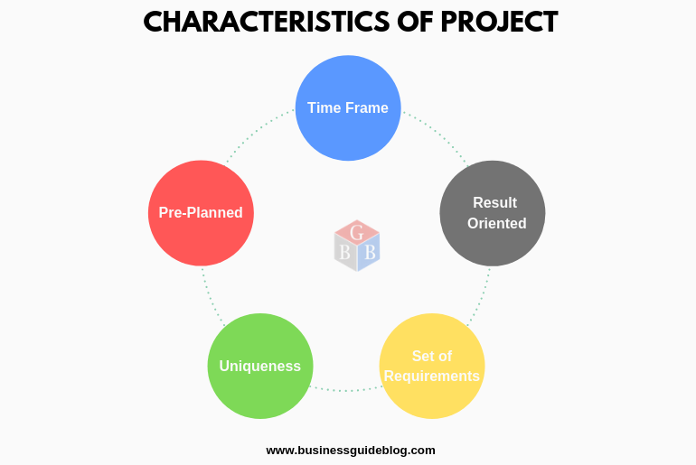
Key Characteristics
Non-routine
Specific deliverables
Time restrictions
Many tasks
Coordinated

Slide 4
Software
Management
Project Management
Software Project Management

Slide 5
Software Projects
We also need to keep following factors in mind when working on software projects:
Invisibility
Complexity
Flexibility

Slide 6
Software Projects:
Invisibility Progress is not immediately visible
Complexity Difficult to measure cost/time
Flexibility Subject to high degree of change

Slide 7
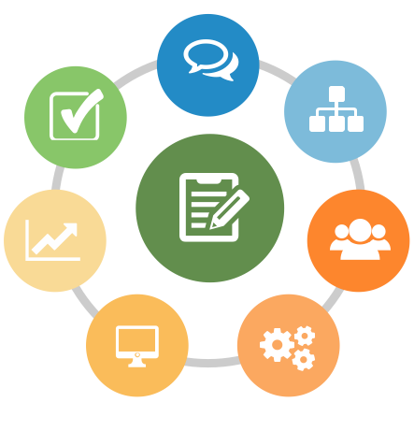
Software Project Management
Note:
A software project is not just concerned with the actual writing of software
Why Manage?
To Complete Project on Time
To Keep Project Cost Under Control
To Deliver What’s Promised (Scope)

Slide 8
Universal Constraints:
The three universal project constraints you will always face are:
Time
Cost
Scope

Slide 9
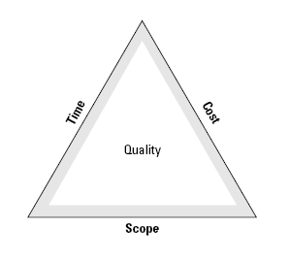
Iron Triangle
In order to achieve quality in the project deliverable, and in the management of the project, the Iron Triangle must remain balanced

Slide 10
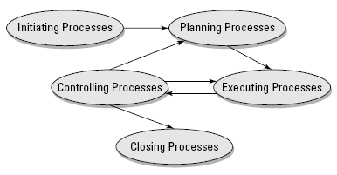
PMI Process Groups
Before that, it is important to acquire the project

Slide 11
Software Project Acquisition
The first activity in software project management is the acquisition of a project.
Software can be acquired either from:
An external client
An internal client

Slide 12
Project acquisition from an external client
The request for proposal
The proposal
Negotiation
Contract acceptanec

Slide 13
Request for Information (RFI)
In the RFI, you present your wish list, which details your best-case scenario of what you’ll need.
In addition to basic questions about price and cost, your RFI may contain the following list of questions:
The software testing application must integrate with the development database residing on our on-site servers.
Is any specialized hardware required on our end?
How long has your company been providing application-testing services?
What are the general qualifications of the personnel who would be providing software-testing services?
Can you perform the software testing on-site, or do we have to come to you?

Slide 14
Request for Proposals (RFP)
A Request for Proposals (RFP) is the organisation’s request for various vendors to provide their proposals
In the RFP, they specify exactly what they want vendors to supply
they also provide the logistical and service requirements
Logistical Requirements are the delivery and installation timelines for any equipment and products
Service Requirements are contracts concerning warranties, maintenance, and upgrades after any warranties expire

Slide 15
Request for Proposals (RFP)
Name and details:
of the prospective client
of the project
Contact details:
for the project coordinator of the prospective client
Scope:
of the work and terms of reference
Bidding details:
format of the bid document
any requirements for a bank guarantee/earnest money deposit toward project execution warranty
Procedure:
for evaluating bids that are received by the prospective client
Important dates:
for requesting clarification
for submission of bid
for awarding of the project; etc.

Slide 16
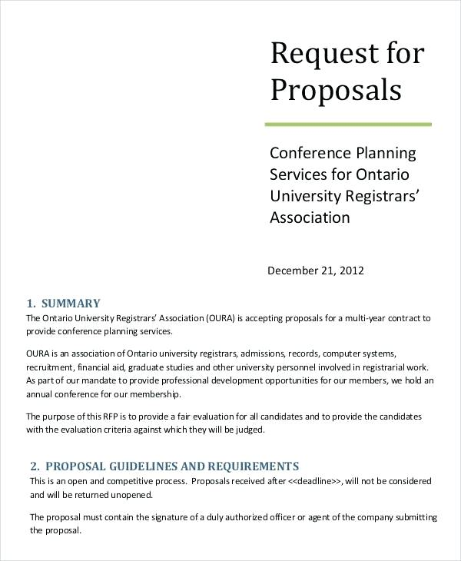
A Partial RFP for example

Slide 17
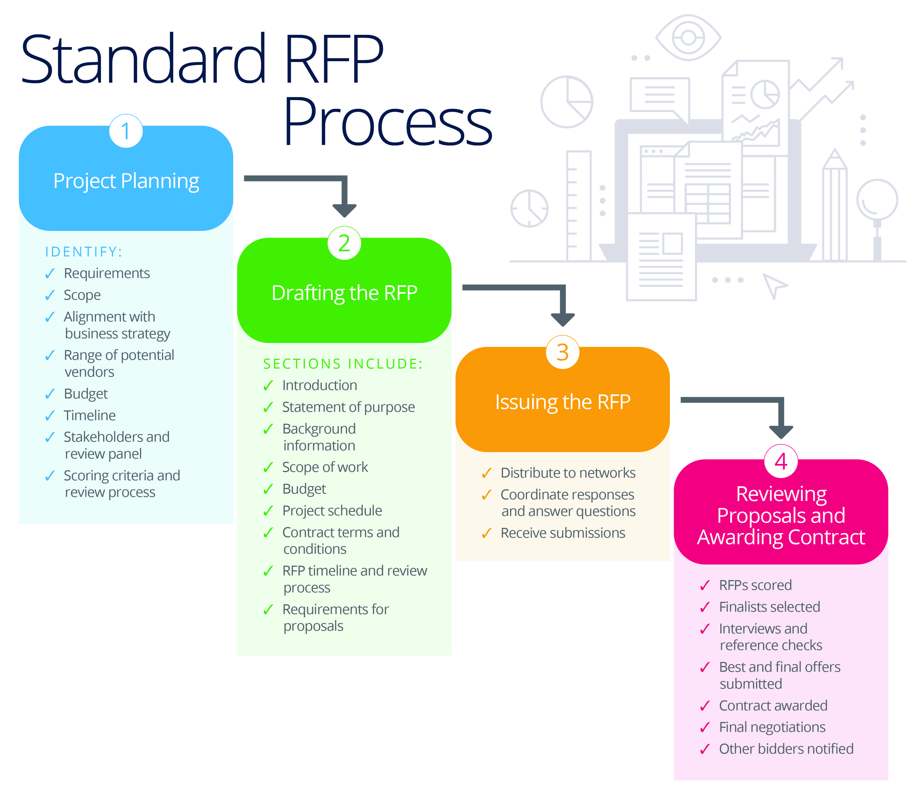

Slide 18
Proposal
A proposal is a starting point of a business decision.
A proposal is a single, separate option that is being considered, such as carrying out a particular software development project or not
Another proposal could be to enhance an existing program, and still another might be to redevelop that same software from scratch
The whole purpose of business decision making is to figure out, given the current business circumstances, which proposals should be carried out and which ones shouldn't

Slide 19
For proposal preparation
Software estimation
Delivery commitments
Pricing the proposal
Preparing the proposal

Slide 20
Preparing the proposal
A technical proposal
A financial proposal

Slide 21
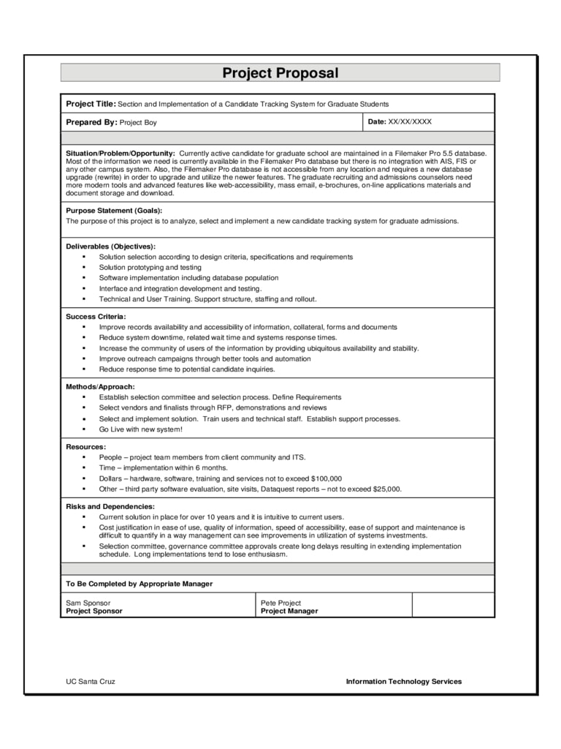

Slide 22
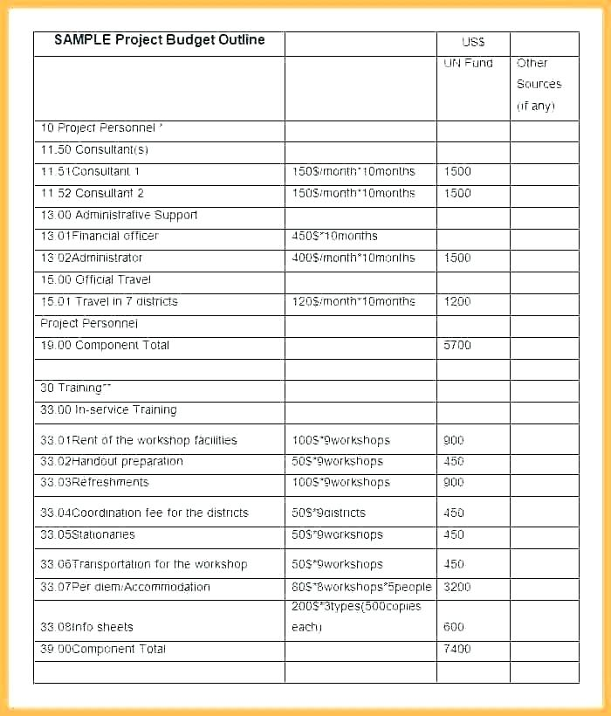

Slide 23
Negotiation
Have to negotiate the final contract
Price
Iron Triangle
Timelines and benchmarks
Include penalties for not meeting targets
How much support in manpower and equipment you need
Other resources with costs are accounted for in writing (delivery cost)

Slide 24
Negotiation
Public bidding:
a prospective client posts an RFP on the Internet or in the press and invites bids from all organizations that meet the criteria contained in the RFP.
Private biding:
In a private bidding scenario, two options are possible:
An RFP is raised on multiple prequalified vendors.
An RFP is raised on only one prequalified vendor. (This scenario occurs when an established relationship exists between a client and a vendor.)
Synthesis biding:
Open solicitation is combined with the use of a strong core of favored/preferred vendors.

Slide 25
Contract Acceptance
Price, delivery date, and payment terms are in agreement with those specified in the order.
All terms and conditions agreed upon and those specified in the order are in agreement.
Any new conditions are inserted in the order
The scope of work is as agreed

Slide 26
Project acquisition from an internal client
The feasibility study
Preparing the proposal
Finalizing the proposal

Slide 27
The feasibility study
User requirements
Technology requirements
Software devlopment approach
Type of execution
Tangible and intangible benfits

Slide 28
Preparing the proposal
Proposal for the internal client has same
Documentation
Procedure
as for external clients

Slide 29
Finalizing the proposal
The proposal is discussed with the internal client
ensure that all of their requirements as approved in the budget are met
the proposed expenditure and timelines meet their expectations.
Any feedback received is implemented in the proposal.
Once the proposal is approved by the internal client, the project is ready for execution.
Note:
In internal projects, the emphasis is not on price, but rather on functionality, expenditures, and meeting required timelines

Slide 30
Reference:
Chapter 3: Software Project Acquisition
Chemuturi, M., & Cagley, T. M. (2010). Mastering software project management: Best practices, tools and techniques. J. Ross Publishing.

Slide 31
Q & A

